Slide 1



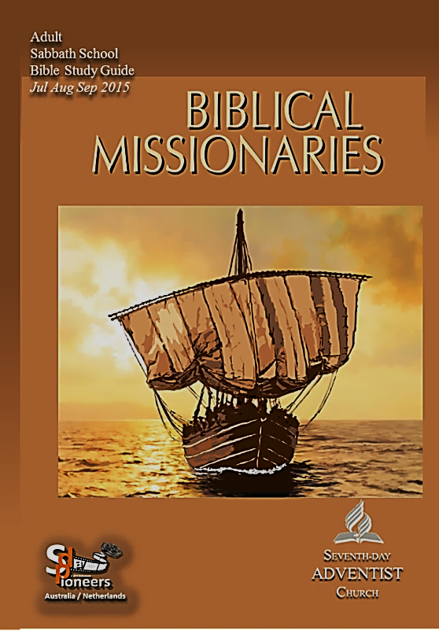


sdapioneers@hotmail.com
3rd Quarter 2015
The Missionary Nature
of God
1
LESSON
June 27–July 4

Slide 2
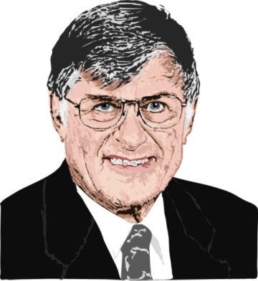


sdapioneers@hotmail.com
Introduction
Børge Schantz
(1931-2014)
Børge Schantz
and Steven Thompson
Biblical Missionaries
God’s first earthly journey recorded in the Bible was a missionary journey —walking to and fro in search of Adam and Eve.
1
LESSON

Slide 3
sdapioneers@hotmail.com
Introduction
From the very beginning, it has been God’s mission to seek and
to save those who are lost.
After you have studied the Sabbath School Lessons, Biblical Missionaries, you will have a deepened gratitude for and a heightened commitment to God’s saving mission in Christ.
1
LESSON

Slide 4


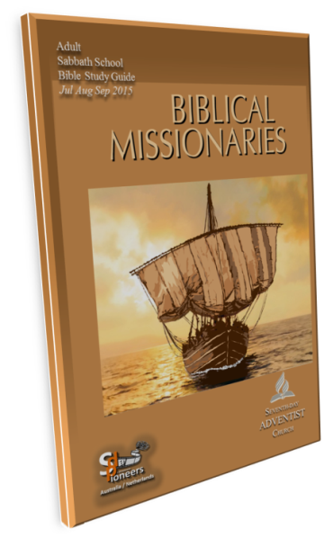

sdapioneers@hotmail.com
The Missionary Nature of God
Memory Text:
“See, I have made him
a witness to the peoples,
a leader and commander
of the peoples”
Isaiah 55:4
1
LESSON
SABBATH AFTERNOON

Slide 5
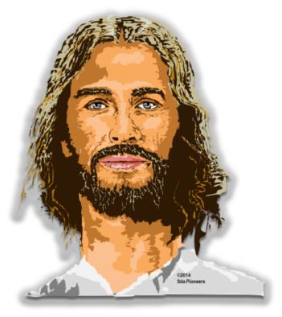

sdapioneers@hotmail.com
God Created Man and Woman
SKIM
through
Genesis 1 and 2,
but focus
especially on
Genesis 1:26–28.
1
LESSON
SUNDAY

Slide 6

sdapioneers@hotmail.com
God Created Man and Woman
What great differences appear
in the creation of humanity
as opposed to everything
else seen in the texts?
What is it about humans
that stands out from other
parts of this creation?
1
LESSON
SUNDAY

Slide 7

sdapioneers@hotmail.com
God Created Man and Woman
Man and woman
were created
at last, and differed
of all the other creatures. They were created in God’s image and likeness.
1
LESSON
SUNDAY

Slide 8

sdapioneers@hotmail.com
God Created Man and Woman
Man and woman were to have dominion,
to represent God
on earth, and rule
over the rest
of creation.
This calling entails responsibility.
1
LESSON
SUNDAY

Slide 9
sdapioneers@hotmail.com
God Created Man and Woman
Humans are introduced in the Bible
in the first chapter, but not in isolation.
We exist, but in relationship to God.
What does this tell us about how
central God should be to our lives
and why we are not really
“complete” without Him?
See also Acts 17:28.
1
LESSON
SUNDAY

Slide 10


sdapioneers@hotmail.com
Free Will
WHAT
does Genesis
2:15–17 say about
the reality of free
will in humanity?
1
LESSON
MONDAY

Slide 11
sdapioneers@hotmail.com
Free Will
What are some of the free moral
choices you have to make in the next
few hours, days, weeks?
How can you be sure you are
using this sacred gift
in the right way?
Think through the consequences
of the wrong use of it.
1
LESSON
MONDAY

Slide 12

sdapioneers@hotmail.com
The Fall
“When the woman saw that the fruit
of the tree was good for food and
pleasing to the eye, and also desirable
for gaining wisdom, she took some
and ate it. She also gave some
to her husband, who was with her,
and he ate it…
1
LESSON
TUESDAY – Part 1

Slide 13

sdapioneers@hotmail.com
The Fall
…Then the eyes of both
of them were opened, and
they realized they were naked;
so they sewed fig leaves
together and made coverings
for themselves”
Gen. 3:6, 7
1
LESSON
TUESDAY – Part 2

Slide 14
sdapioneers@hotmail.com
The Fall
In the context of today’s lesson,
read 1 John 2:16.
How were the elements
warned about in this
text seen in the Fall?
In what ways do we have
to deal with these same
temptations in our lives, as well?
1
LESSON
TUESDAY

Slide 15

sdapioneers@hotmail.com
God’s Initiative to Save Us
WHAT
do each of
these texts teach
us about the death
of Jesus?
John 3:14, 15
Isa. 53:4–6
2 Cor. 5:21
1
LESSON
WEDNESDAY

Slide 16



sdapioneers@hotmail.com
Metaphors of Mission
READ
Matthew 5:13, 14. What are the two metaphors used
for mission in
these texts, and
what do they
stand for?
1
LESSON
THURSDAY

Slide 17
sdapioneers@hotmail.com
Metaphors of Mission
Light and/or salt, how good
a witness are you and your
church to the surrounding world?
Is the light dimming, is
the salt losing its punch?
If so, how can you learn that
revival and reformation
begins with you, personally?
1
LESSON
THURSDAY

Slide 18

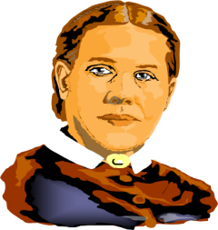
sdapioneers@hotmail.com
Further Study:
Quote Ellen G. White
“The church of Christ on earth was organized for missionary purposes, and the Lord desires to see the entire church devising ways and means whereby high and low, rich and poor,
may hear the message of truth. Not all are
called to personal labor in foreign fields,
but all can do something by their prayers
and their gifts to aid the missionary work.”
—Ellen G. White,
Testimonies for the Church, vol. 6, p. 29.
1
LESSON
FRIDAY

Slide 19
sdapioneers@hotmail.com
Discussion Questions:
Think more about the question of origins. Why do origins matter?
How does a proper understanding
of our origins help us better
to understand who we are
and what the purpose
of our existence really is?
1
LESSON
FRIDAY – Question 1

Slide 20
sdapioneers@hotmail.com
Discussion Questions:
How does the following quote help us to understand the existence of free will, love, and evil in our world?
“Thus, if God wants to create loving creatures (in imitation of his perfect love), God has to create free beings
who can cause suffering and evil in
the world by their choices.
1
LESSON
FRIDAY – Question 2- first part

Slide 21
sdapioneers@hotmail.com
Discussion Questions:
The dynamics of love and
freedom require that God allow
us the latitude to grow in love through our human freedom. God’s only alternative to allowing free beings to choose unloving acts is to completely refrain from creating loving creatures.”
1
—Robert J. Spitzer, New Proofs for the
Existence of God: Contributions of Contemporary Physics
and Philosophy, Kindle Edition
(Eerdmans Publishing Co., 2010), p. 233.
LESSON
FRIDAY – Question 2- second part

Slide 22
sdapioneers@hotmail.com
Discussion Questions:
The death of Jesus was a single act that
occurred in a small nation amid the
vast Roman Empire almost two thousand
years ago. Yet, this act is of eternal
significance for every human being.
What responsibility rests on us, who
know about this act and what it means,
to tell those who don’t know about it?
How else will they learn of it if those
who know about it don’t tell them?
1
LESSON
FRIDAY – Question 3

Slide 23


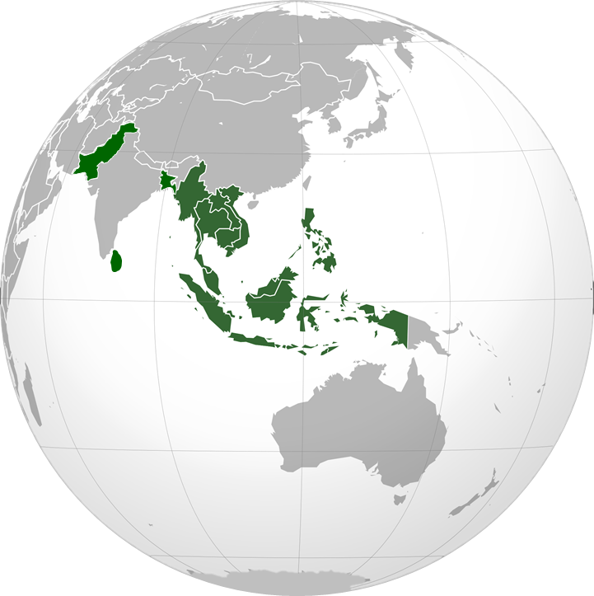
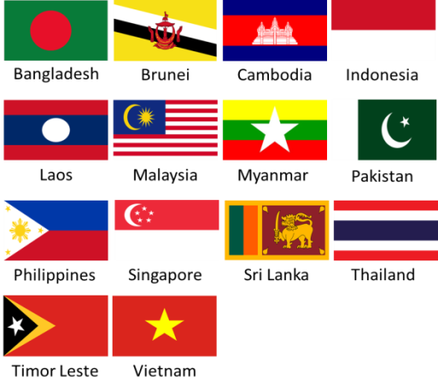
MISSION
YOUTH & ADULT
2015- Quarter 3
THE SOUTHERN ASIA-PACIFIC
DIVISION (SSD)
includes the countries of :
Bangladesh, Brunei,
Cambodia, Indonesia,
Laos, Malaysia, Myanmar,
Pakistan, Philippines,
Singapore, Sri Lanka,
Thailand, Timor Leste
and Vietnam.

Slide 24

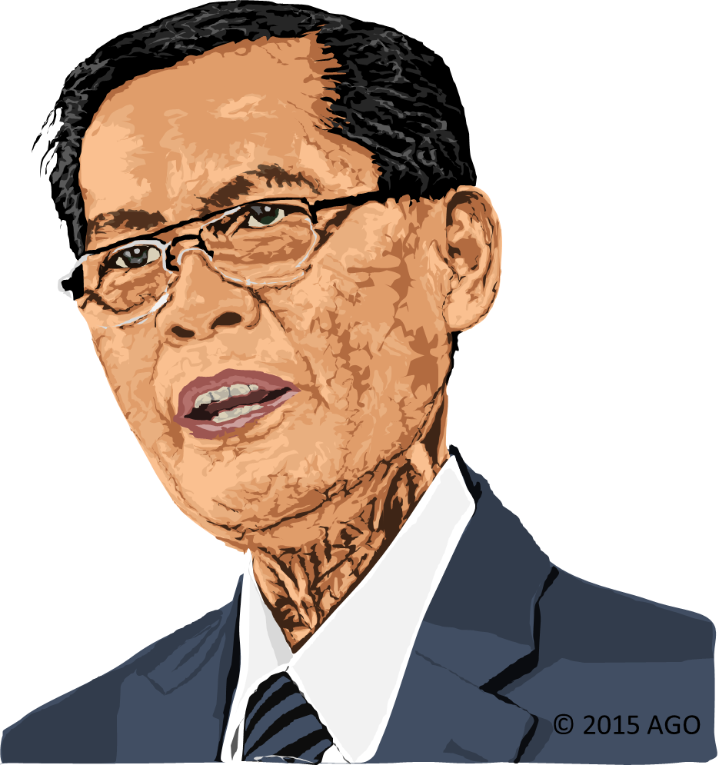
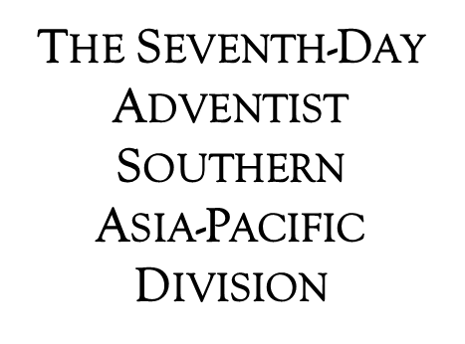
MISSION
YOUTH & ADULT
2015- Quarter 3
Churches: 7055
Members: 1,249,121
Population: 994,404,000
Pastor Alberto C. Gulfan, Jr.
President of the SSD
since May-2003
He is married to the
former Helen Bocala and blessed
with three grown children,
all married,
and two grandsons.

Slide 25
MISSION
YOUTH & ADULT
2015- Quarter 3
Thirteen Sabbath's Offering​
Southern Asia-Pacific Division September 26 - 2015
PROJECTS:
Timor-Leste Adventist International School (TAIS) in the Capital City of Dili
​Lakpahana Adventist College and Seminary Church in Lakpahana, Sri Lanka
Bangladesh Adventist Nursing School in Gazipur, Bangladesh
Children's Project: Desks for the School Children at TAIS

Slide 26

MISSION
YOUTH & ADULT
2015- Quarter 3
ADVENTIST MISSION EAST TIMOR
JULY 4 - 2015
PRAY FOR US
1
1
SABBATH- JULY 4

Slide 27

sdapioneers@hotmail.com
3rd Quarter 2015
1
LESSON

