Slide 1



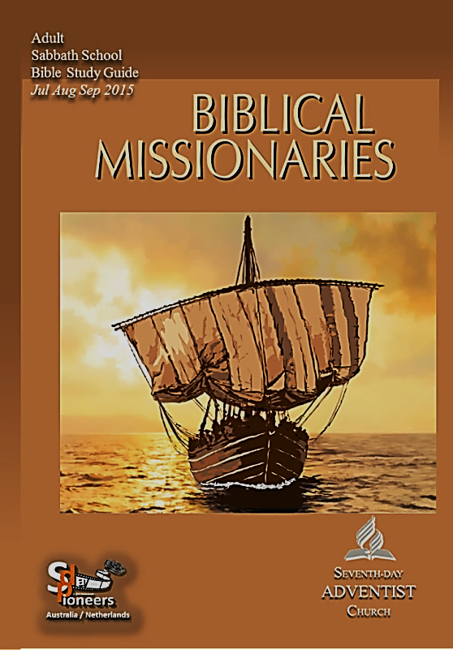


sdapioneers@hotmail.com
3rd Quarter 2015
Abraham: The First
Missionary
2
LESSON
July 4–July 11

Slide 2


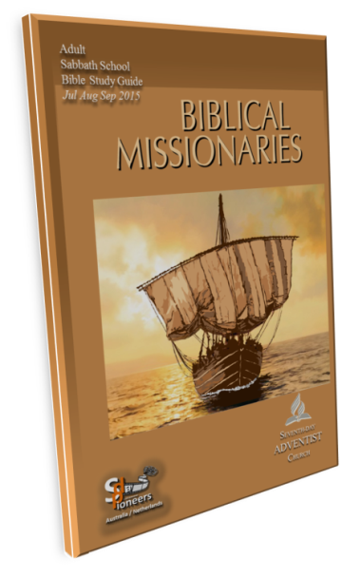

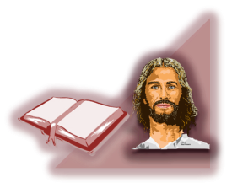
sdapioneers@hotmail.com
Abraham: The First Missionary
Memory Text:
“So also Abraham ‘believed God,
and it was credited
to him as righteousness.’
Understand, then, that those who have
faith are children of Abraham…
2
LESSON
SABBATH AFTERNOON

Slide 3
sdapioneers@hotmail.com
Abraham: The First Missionary
Memory Text:
…Scripture foresaw that God would
justify the Gentiles by faith,
and announced the gospel in
advance to Abraham: ‘All nations
will be blessed through you’ ”
Galatians 3 : 6–8
2
LESSON
SABBATH AFTERNOON

Slide 4


sdapioneers@hotmail.com
Abraham: The First Missionary
Key Text:
“By faith Abraham, when he was called
to go out into a place which he should
after receive for an inheritance,
obeyed; and he went out, not knowing
whither he went.”
Hebrews 11:8
2
LESSON

Slide 5
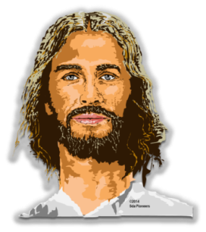
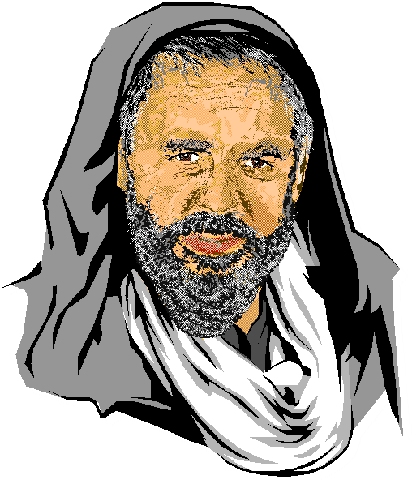
sdapioneers@hotmail.com
The Call of Abraham
“The Lord had said to Abram,
‘Go from your country, your
people and your father’s household
to the land I will show you. I
will make you into a great nation,
and I will bless you;…
2
LESSON
SUNDAY

Slide 6
sdapioneers@hotmail.com
The Call of Abraham
…I will make your name great,
and you will be a blessing.
I will bless those who
bless you, and whoever curses you
I will curse; and all peoples on
earth will be blessed through you’ ” Genesis 12 : 1–3
2
LESSON
SUNDAY

Slide 7


sdapioneers@hotmail.com
The Call of Abraham
READ
through Genesis 12:1–3. What principles can you find here that
could apply to any of us in our
own particular situation; that is,
what did Abraham experience that we might experience in our own way,
as well? See also Heb. 11:8–10.
2
LESSON
SUNDAY

Slide 8

sdapioneers@hotmail.com
The Call of Abraham
In Genesis, the Hebrew reads literally, “And God said to Abram,
‘Go for yourself from your land.’ ” He was told to go “for himself”;
that is, for his own sake.
How should we understand
what that means, and how
can we apply it to ourselves?
2
LESSON
SUNDAY

Slide 9
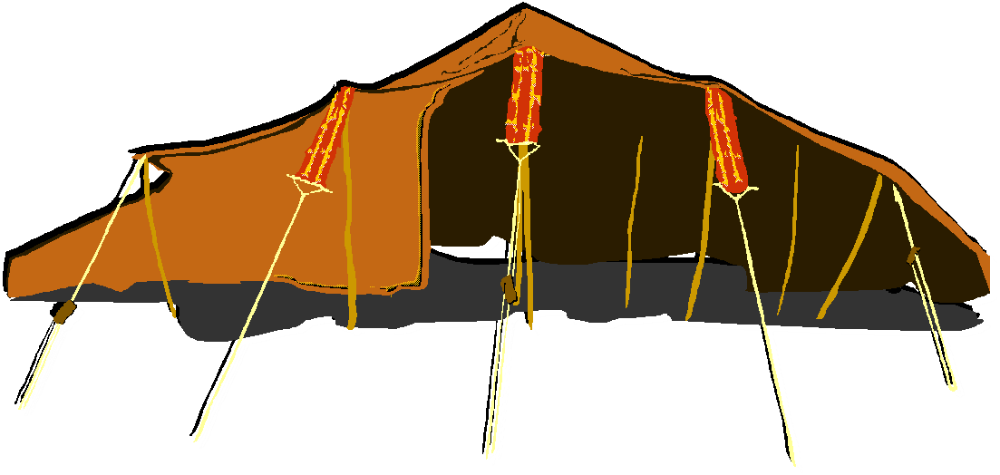

sdapioneers@hotmail.com
Abraham’s Testimony to the Kings
READ
Genesis 14:8–24.
What did Abraham’s actions
say about his
character and, hence,
about his faith and his God?
2
LESSON
MONDAY

Slide 10
sdapioneers@hotmail.com
Abraham’s Testimony to the Kings
Think about your dealings
with others.
What kind of witness
do they present to
others about your faith?
2
LESSON
MONDAY

Slide 11
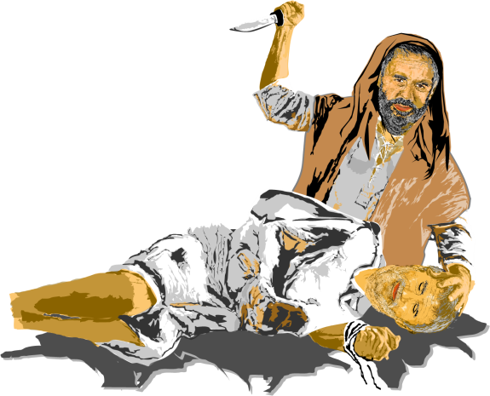
sdapioneers@hotmail.com
Exemplar of Faith
READ
Hebrews 11:8–19.
What does it tell us about
Abraham and his faith that
is so important for anyone
who wants to be a missionary
for God in whatever
capacity possible?
2
LESSON
TUESDAY

Slide 12
sdapioneers@hotmail.com
Exemplar of Faith
In what ways have you
experienced what it means to step out in faith? What hardships have you faced? What joys have you
experienced? Knowing what you know now, what might you have
done differently?
2
LESSON
TUESDAY

Slide 13
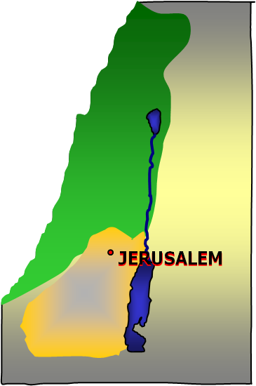
sdapioneers@hotmail.com
Abraham, the Wanderer
WHAT
were some of the spiritual
lessons that Abraham
experienced in
the following places?
Moreh at Shechem
(Gen. 12:6, 7)
2
LESSON
WEDNESDAY - 1

Slide 14
sdapioneers@hotmail.com
Abraham, the Wanderer
Hebron
(Gen. 13:18–14:20)
Mamre
(Gen. 18:1, 20–33)
Mount Moriah
(Gen. 22:1–14)
2
LESSON
WEDNESDAY - 2

Slide 15
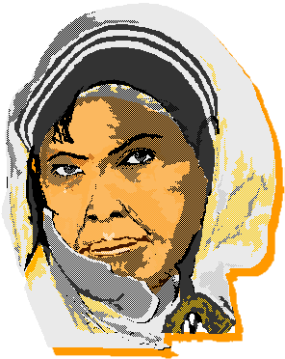
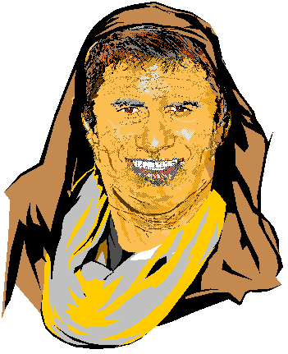
sdapioneers@hotmail.com
Abraham: A Missionary in His Own House
“ ‘Abraham will surely
become a great and
powerful nation, and all nations
on earth will be blessed through him.
For I have chosen him, so that he will direct his children and his household…
2
LESSON
THURSDAY - 1

Slide 16
sdapioneers@hotmail.com
Abraham: A Missionary in His Own House
…after him to keep the
way of the Lord by doing
what is right and just, so that the
Lord will bring about for Abraham
what he has promised him’ ”.
(Genesis 18 : 18, 19 )
2
LESSON
THURSDAY - 2

Slide 17
sdapioneers@hotmail.com
Abraham: A Missionary in His Own House
WHAT
examples of
Abraham’s family can
you find that showed that
they were faithful to the Lord?
See, for example, Heb. 11:11, 20.
2
LESSON
THURSDAY - 3

Slide 18
sdapioneers@hotmail.com
Abraham: A Missionary in His Own House
To “keep the way of the Lord.”
What does that phrase
mean to you?
How are we to
“keep the way of the Lord”?
2
LESSON
THURSDAY - 4

Slide 19

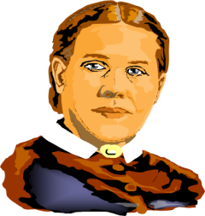
sdapioneers@hotmail.com
Further Study:
Quote Ellen G. White
“God called Abraham, and prospered
and honored him; and the patriarch’s fidelity was a light to the people in all
the countries of his sojourn. Abraham
did not shut himself away
from the people around him…”
—Ellen G. White,
Patriarchs and Prophets, p. 368.
2
LESSON
FRIDAY

Slide 20
sdapioneers@hotmail.com
Discussion Questions:
For thousands of years, the story
of Abraham and Isaac…
Read the story over again in Genesis 22. What great lessons can we take from it? What does it teach us about the Cross and the terrible cost of sin? What does
it teach us about what taking a leap of faith entails? Why is the story
so troubling to many?
2
LESSON
FRIDAY – Question 1

Slide 21
sdapioneers@hotmail.com
Discussion Questions:
Read Genesis 12:11–13, 20:2,
two accounts where Abraham,
a man of God, showed a lack of faith.
What can we take away
from these stories?
2
LESSON
FRIDAY – Question 2

Slide 22
sdapioneers@hotmail.com
Discussion Questions:
One of the most famous texts in
the Bible is Genesis 15:6.
What does it say? In what context is it given? How is this text used in the
New Testament
(see Rom. 4:3, Gal. 3:6, James 2:23)?
What does it teach us about faith, works, and salvation?
2
LESSON
FRIDAY – Question 3

Slide 23
sdapioneers@hotmail.com
Discussion Questions:
Who were some of the great religious leaders whose family members didn’t follow in “the way of the Lord”?
What can we learn from their stories that can encourage anyone who struggles with helping family
members be faithful?
2
LESSON
FRIDAY – Question 4

Slide 24


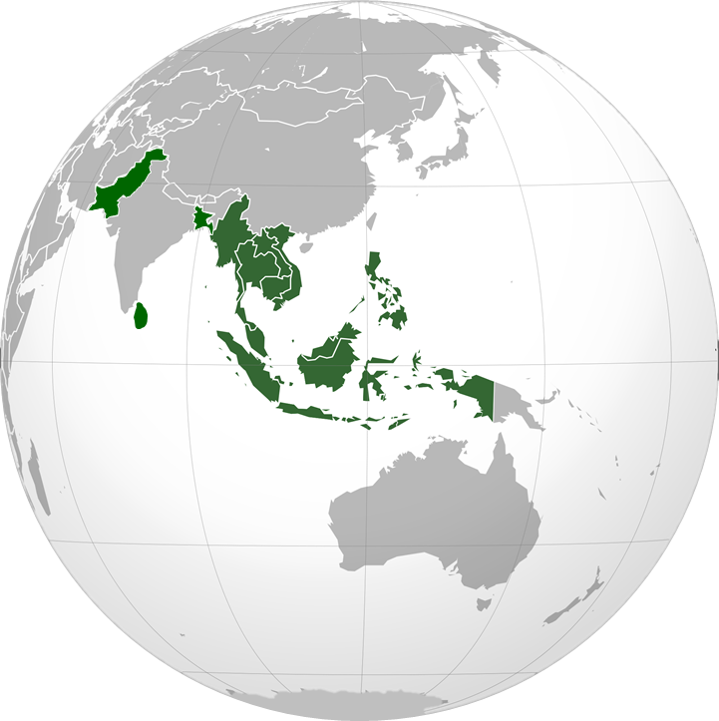
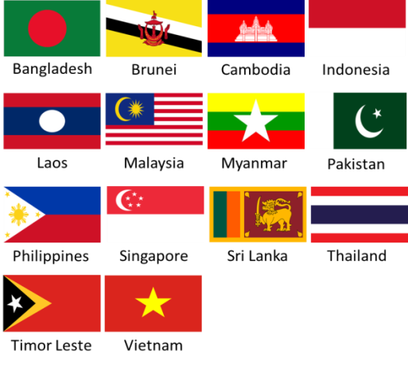
MISSION
YOUTH & ADULT
2015- Quarter 3
THE SOUTHERN ASIA-PACIFIC
DIVISION (SSD)
includes the countries of :
Bangladesh, Brunei,
Cambodia, Indonesia,
Laos, Malaysia, Myanmar,
Pakistan, Philippines,
Singapore, Sri Lanka,
Thailand, Timor Leste
and Vietnam.

Slide 25

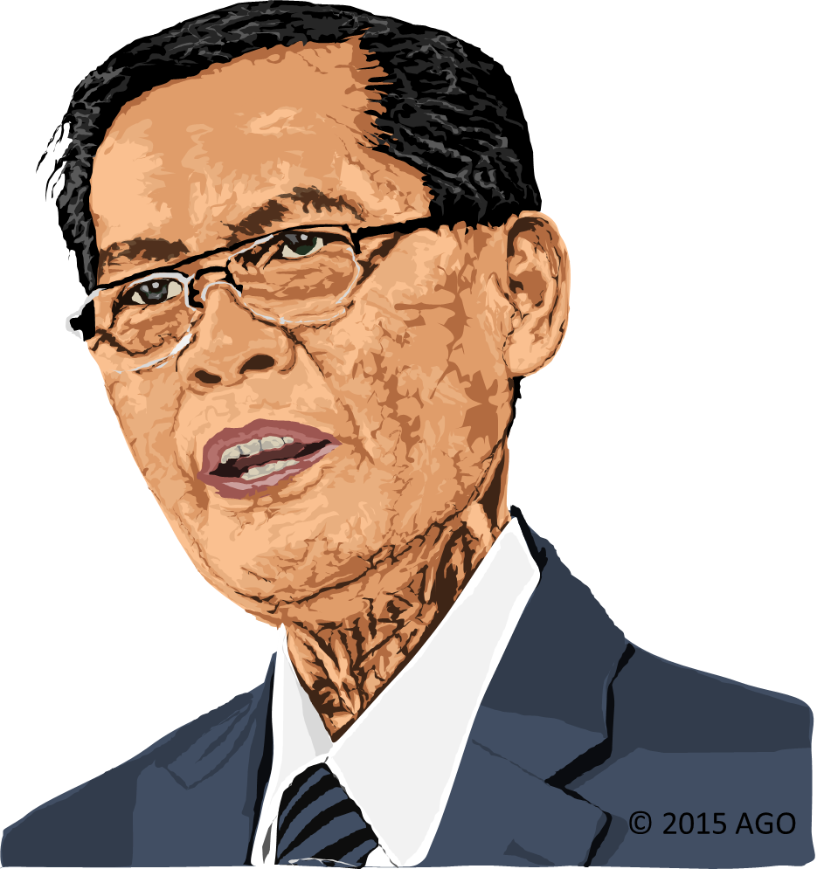
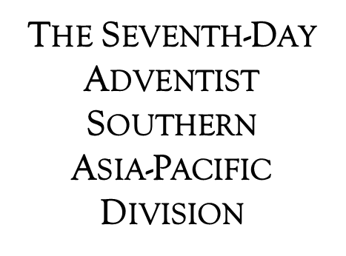
MISSION
YOUTH & ADULT
2015- Quarter 3
Churches: 7055
Members: 1,249,121
Population: 994,404,000
Pastor Alberto C. Gulfan, Jr.
President of the SSD
since May-2003
He is married to the
former Helen Bocala and blessed
with three grown children,
all married,
and two grandsons.

Slide 26
MISSION
YOUTH & ADULT
2015- Quarter 3
Thirteen Sabbath's Offering​
Southern Asia-Pacific Division September 26 - 2015
PROJECTS:
Timor-Leste Adventist International School (TAIS) in the Capital City of Dili
​Lakpahana Adventist College and Seminary Church in Lakpahana, Sri Lanka
Bangladesh Adventist Nursing School in Gazipur, Bangladesh
Children's Project: Desks for the School Children at TAIS

Slide 27

MISSION
YOUTH & ADULT
2015- Quarter 3
ADVENTIST MISSION
EAST TIMOR
JULY 11 - 2015
ALWAYS WITH JESUS
2
2
SABBATH - JULY 11

Slide 28

sdapioneers@hotmail.com
3rd Quarter 2015
2
LESSON

